Slide 1
COMPUTER NETWORKS
CS610
Lecture-5
Dr.M.Sheraz Malik

Slide 2
Review Lecture 4
The Concept of Packets
Why use Packets?
Packets and Frames
Byte Stuffing

Slide 3
Byte Stuffing
Sometimes, the special characters (i.e. soh or eot) may appear in the data
Problem: soh and eot as part of data will be misinterpreted as framing data
Solution: Byte stuffing

Slide 4
Byte Stuffing (cont’d)
Byte stuffing translates each reserved byte into two unreserved bytes
For example, can use esc as prefix, followed by x for soh, y for eot and z for esc

Slide 5
Byte Stuffing (cont’d)
The sender replaces each occurance of special characters with a combination of two characters (i.e.esc x, esc y, esc z)
The receiver then replaces each occurence of esc x, esc y, esc z, by the corresponding single character

Slide 6
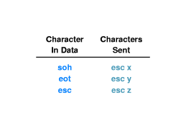
Byte Stuffing (cont’d)

Slide 7
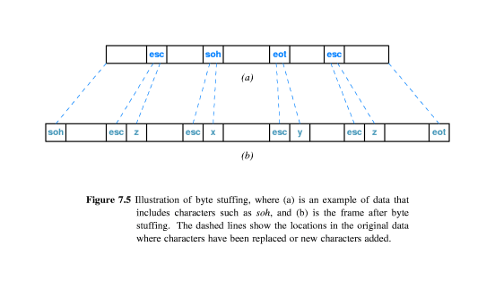
Byte Stuffing (cont’d)

Slide 8
Transmission Errors
Interference or power surges may destroy data during transmission
  Bits may be lost
  Bit values may be changed
Frames include additional information to detect / correct errors
  Inserted by the sender
  Checked by the receiver

Slide 9
Error Detection & Correction
Error detection - send additional information so that incorrect data can be detected and rejected
Error correction - send additional information so that incorrect data can be corrected and accepted

Slide 10
Parity Checking
Parity refers to the number of bits set to 1 in the data item
  Even parity - An even number of bits are 1
  Odd parity - An odd number of bits are 1

Slide 11
Parity Checking
A Parity Bit is an extra bit transmitted with a data item, chose to give the resulting bits even or odd parity
  Even parity - data: 10010001, parity bit 1
  Odd parity - data: 10010111,
  parity bit 0

Slide 12
Parity and Error Detection
If noise or other interference introduces an error, one of the bits in the data will be changed from a 1 to a 0 or from a 0 to a 1
Parity of resulting bits will be wrong
  Original data and parity: 10010001+1 (even parity)
  Incorrect data: 10110001+1 (odd parity)

Slide 13
Limitations of Parity Checking
Parity can only detect errors that change an odd number of bits
  Original data and parity: 10010001+1 (even parity)
  Incorrect data: 10110011+1 (even parity!)
Parity usually used to catch one-bit errors

Slide 14
Alternative Error Detection Schemes
Alternative error detection mechanisms have been introduced
Differences among mechanisms:
  The size of the additional information (transmission overhead)
  Computational complexity of the algorithm (computational overhead)
  The number of bit error that can be detected (how well errors are detected)

Slide 15
Checksum
Checksum is calculated before transmission
  Treats data as a sequence of integers
  Computes their arithmetic sum
  Carry bits are added into the final sum
Calculated checksum is sent along with data
Receiver then performs the same calculation

Slide 16
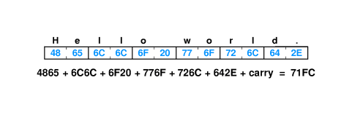
Checksum

Slide 17
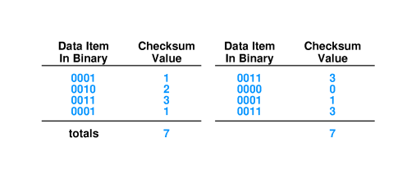
Checksum
Can be 8-, 16- or 32-bit integers
Easy to do - uses only addition
May not detect all errors

Slide 18
Cyclic Redundancy Check (CRC)
Problem : How can a network system detect more errors without increasing the amount of information in each packet?
Answer: Cyclic Redundancy Check (CRC)

Slide 19
Cyclic Redundancy Check (CRC)
Consider data in message as coefficients of a polynomial
Divide that coefficient set by a known polynomial
Transmit remainder as CRC
  Good error detection properties
  Easy to implement in hardware

Slide 20
Hardware Components
Uses two hardware components:
  Shift Register
  Exclusive or (xor) unit

Slide 21
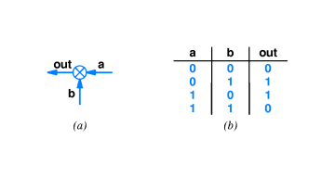
Hardware Components
Exclusive OR (XOR) unit

Slide 22
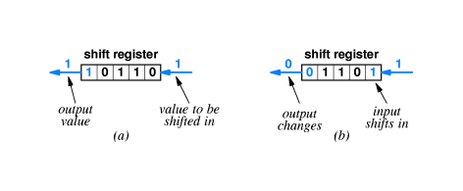
Hardware Components
Shift Register: Performs two operations:
  Initialize : Sets all bits to zero
  Shift: Moves all bits to the left one position

Slide 23
SUMMARY
Byte Stuffing
Transmission Errors
Error Detection
  Parity Check
  Checksum
  CRC

